Slide 1
18- Sets

Slide 2
context
What is a set? 3
set(<iterable>) | built in function 4
setObject.add(anObject) 5
setObject.remove(anObject) 6
len(setObject) : integer | built in function 7
Where does sets shine? 8
setObject1 | setOunion2 | union of two sets 9
setObject1 & setOunion2 | Intersection of two sets 10
setObject1 - setOunion2 | the difference between two sets 11
setObject1 ^ setOunion2 | Symmetric difference 12
sets are unordered collection 13
anObject in setObject | in operator 14

Slide 3
What is a set?
a collection
with no duplicates

Slide 4

set(<iterable>) | built in function
Convert an iterable to a set

Slide 5

setObject.add(anObject)

Slide 6

setObject.remove(anObject)

Slide 7

len(setObject) : integer | built in function

Slide 8
Where does sets shine?
Where sets shine are in the powerful mathematical operations that are supported by them.

Slide 9

setObject1 | setOunion2 | union of two sets
return a new set that includes all the items that are either in the first or in the second set.

Slide 10
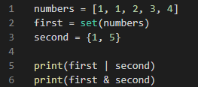

setObject1 & setOunion2 | Intersection of two sets
return a new set that includes all the items that are in both first and second sets.

Slide 11
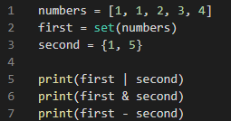

setObject1 - setOunion2 | the difference between two sets
the first set has this additional numbers that we don't have in the second set

Slide 12
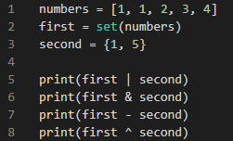

setObject1 ^ setOunion2 | Symmetric difference
This will return the items that are either in the first or second set. but not both

Slide 13
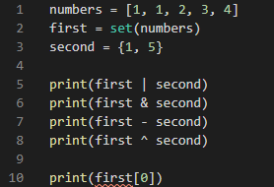
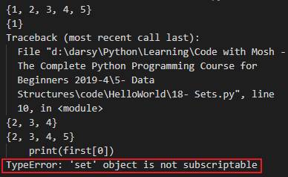
sets are unordered collection
unlike lists they’re unordered collection which means the items that we have in the set are not in sequence so we cannot access them using an index

Slide 14
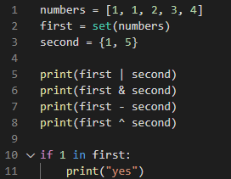
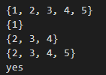
anObject in setObject | in operator
check for the existence of an item in a set

Slide 15
Set is
An unordered collection. They're not in sequence.
so we cannot access them using an index
unique items. We cannot have duplicates.

